Slide 1
Database Systems
Lecture 16
Relational Model Concepts

Slide 2
Today’s Agenda
Relational Model
Domain, tuple, attribute and relation
Characteristics of relation

Slide 3
Relational Model Concepts
The relational model represents the database as a collection of relations.
The relational Model of Data is based on the concept of a Relation.
A Relation is a mathematical concept based on the ideas of sets.
The strength of the relational approach to data management comes from the formal foundation provided by the theory of relations.

Slide 4
Relational Model Concepts
The model was first proposed by Dr. E.F. Codd of IBM in 1970 in the following paper: "A Relational Model for Large Shared Data Banks," Communications of the ACM, June 1970.
The above paper caused a major revolution in the field of Database management and earned Ted Codd the coveted ACM Turing Award.

Slide 5
INFORMAL DEFINITIONS
RELATION: A table of values
A relation may be thought of as a set of rows.
A relation may alternately be thought of as a set of columns.
Each row represents a fact that corresponds to a real-world entity or relationship.
Each row has a value of an item or set of items that uniquely identifies that row in the table.
Sometimes row-ids or sequential numbers are assigned to identify the rows in the table.
Each column typically is called by its column name or column header or attribute name.

Slide 6
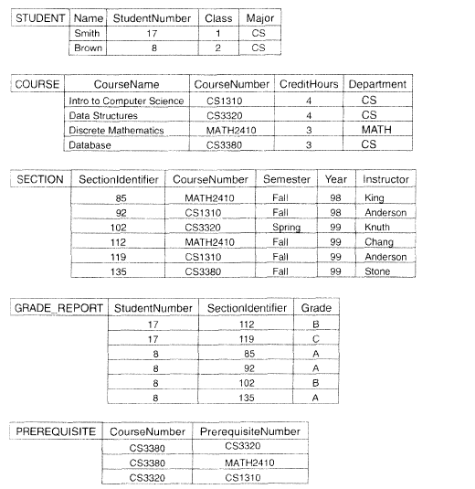

Slide 7
FORMAL DEFINITIONS
A Relation may be defined in multiple ways.
The Schema of a Relation: R (A1, A2, .....An)
Relation schema R is defined over attributes A1, A2, .....An
For Example -
CUSTOMER (Cust-id, Cust-name, Address, Phone#)
Here, CUSTOMER is a relation defined over the four attributes Cust-id, Cust-name, Address, Phone#, each of which has a domain or a set of valid values. For example, the domain of Cust-id is 6 digit numbers.

Slide 8
FORMAL DEFINITIONS
A tuple is an ordered set of values
Each value is derived from an appropriate domain.
Each row in the CUSTOMER table may be referred to as a tuple in the table and would consist of four values.
<632895, "John Smith", "101 Main St. Atlanta, GA 30332", "(404) 894-2000"> is a tuple belonging to the CUSTOMER relation.
A relation may be regarded as a set of tuples (rows).
Columns in a table are also called attributes of the relation.

Slide 9
FORMAL DEFINITIONS
A domain has a logical definition: e.g., “USA_phone_numbers” are the set of 10 digit phone numbers valid in the U.S.
A domain may have a data-type or a format defined for it. The USA_phone_numbers may have a format: (ddd)-ddd-dddd where each d is a decimal digit. E.g., Dates have various formats such as monthname, date, year or yyyy-mm-dd, or dd mm,yyyy etc.
An attribute designates the role played by the domain. E.g., the domain Date may be used to define attributes “Invoice-date” and “Payment-date”.

Slide 10
FORMAL DEFINITIONS
The relation is formed over the cartesian product of the sets; each set has values from a domain; that domain is used in a specific role which is conveyed by the attribute name.
For example, attribute Cust-name is defined over the domain of strings of 25 characters. The role these strings play in the CUSTOMER relation is that of the name of customers.
Formally,
Given R(A₁, A₂, .........., A_{n})
r(R) ⊂ dom (A₁) X dom (A₂) X ....X dom(A_{n})
R: schema of the relation
r of R: a specific "value" or population of R.
R is also called the intension of a relation
r is also called the extension of a relation
Degree of relation is the no-of attributes of its relation schema

Slide 11
FORMAL DEFINITIONS
Let S1 = {0,1}
Let S2 = {a,b,c}
Let R ⊂ S1 X S2
Then for example: r(R) = {<0,a> , <0,b> , <1,c> }
is one possible “state” or “population” or “extension” r of the relation R, defined over domains S1 and S2. It has three tuples.

Slide 12
DEFINITION SUMMARY
Informal Terms | Formal Terms
Table | Relation
Column | Attribute/Domain
Row | Tuple
Values in a column | Domain
Table Definition | Schema of a Relation
Populated Table | Extension

Slide 13
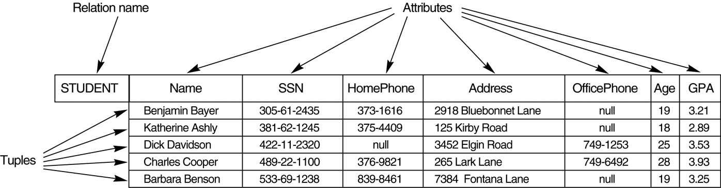
The attributes and tuples of a relation STUDENT

Slide 14
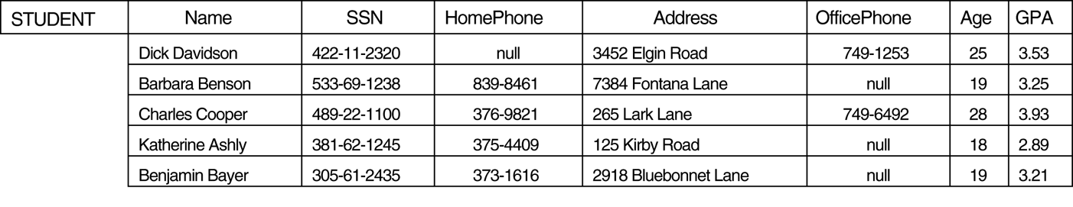
The relation STUDENT with a different order of tuples

Slide 15
CHARACTERISTICS OF RELATIONS
Ordering of tuples in a relation r(R): The tuples are not considered to be ordered, even though they appear to be in the tabular form.
Ordering of attributes in a relation schema R (and of values within each tuple): We will consider the attributes in R(A₁, A₂, ..., A_{n}) and the values in t=<v₁, v₂, ..., v_{n}> to be ordered .
(However, a more general alternative definition of relation does not require this ordering).
Values in a tuple: All values are considered atomic (indivisible). A special null value is used to represent values that are unknown or inapplicable to certain tuples.

Slide 16
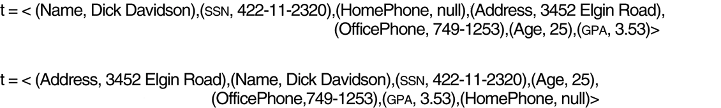
Two identical tuples when the order of attributes and values is not part of relation definition.

Slide 17
CHARACTERISTICS OF RELATIONS
Interpretation (Meaning) of a relation:
The relation schema can be interpreted as a declaration or a type of assertion.

